Slide 1

import smartImport

Slide 2

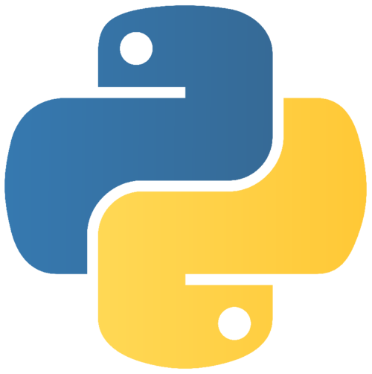
”You don’t know what you don’t know…”
- unknown
88,678 packages in the Python Package Index
Purpose:
Provide recommendations for Python libraries

Slide 3


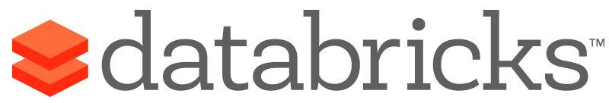




Slide 4

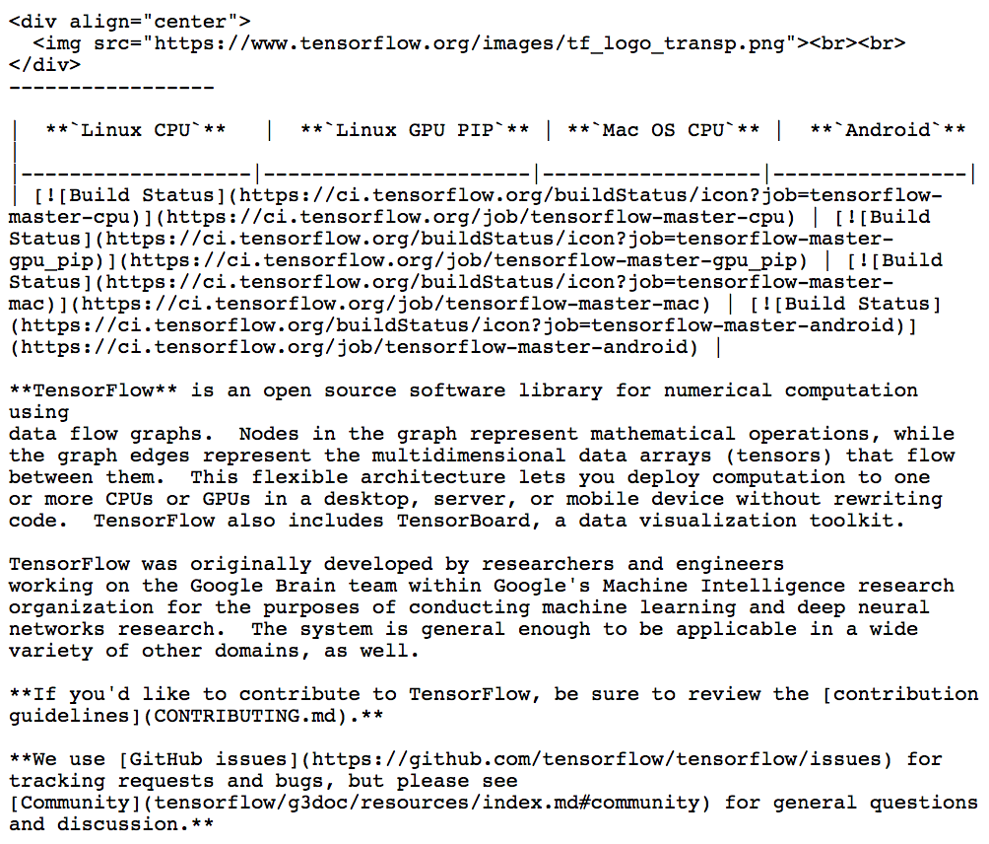
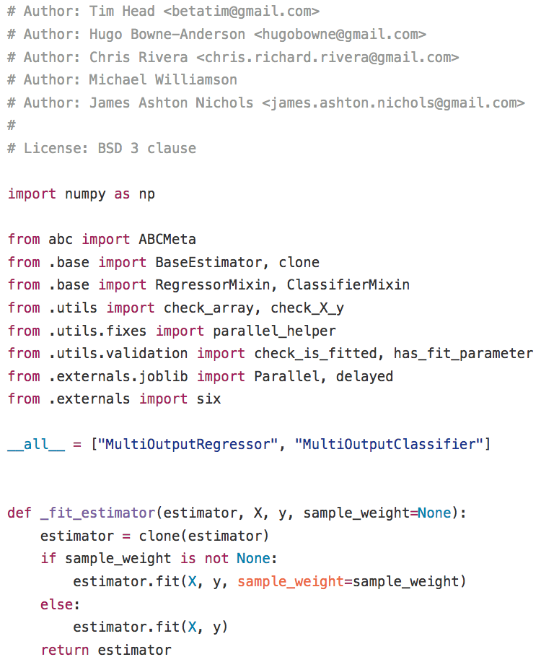
Python
Markdown
2,654 – Repositories
24,010 – Markdown files
99,210 – Python files

Slide 5
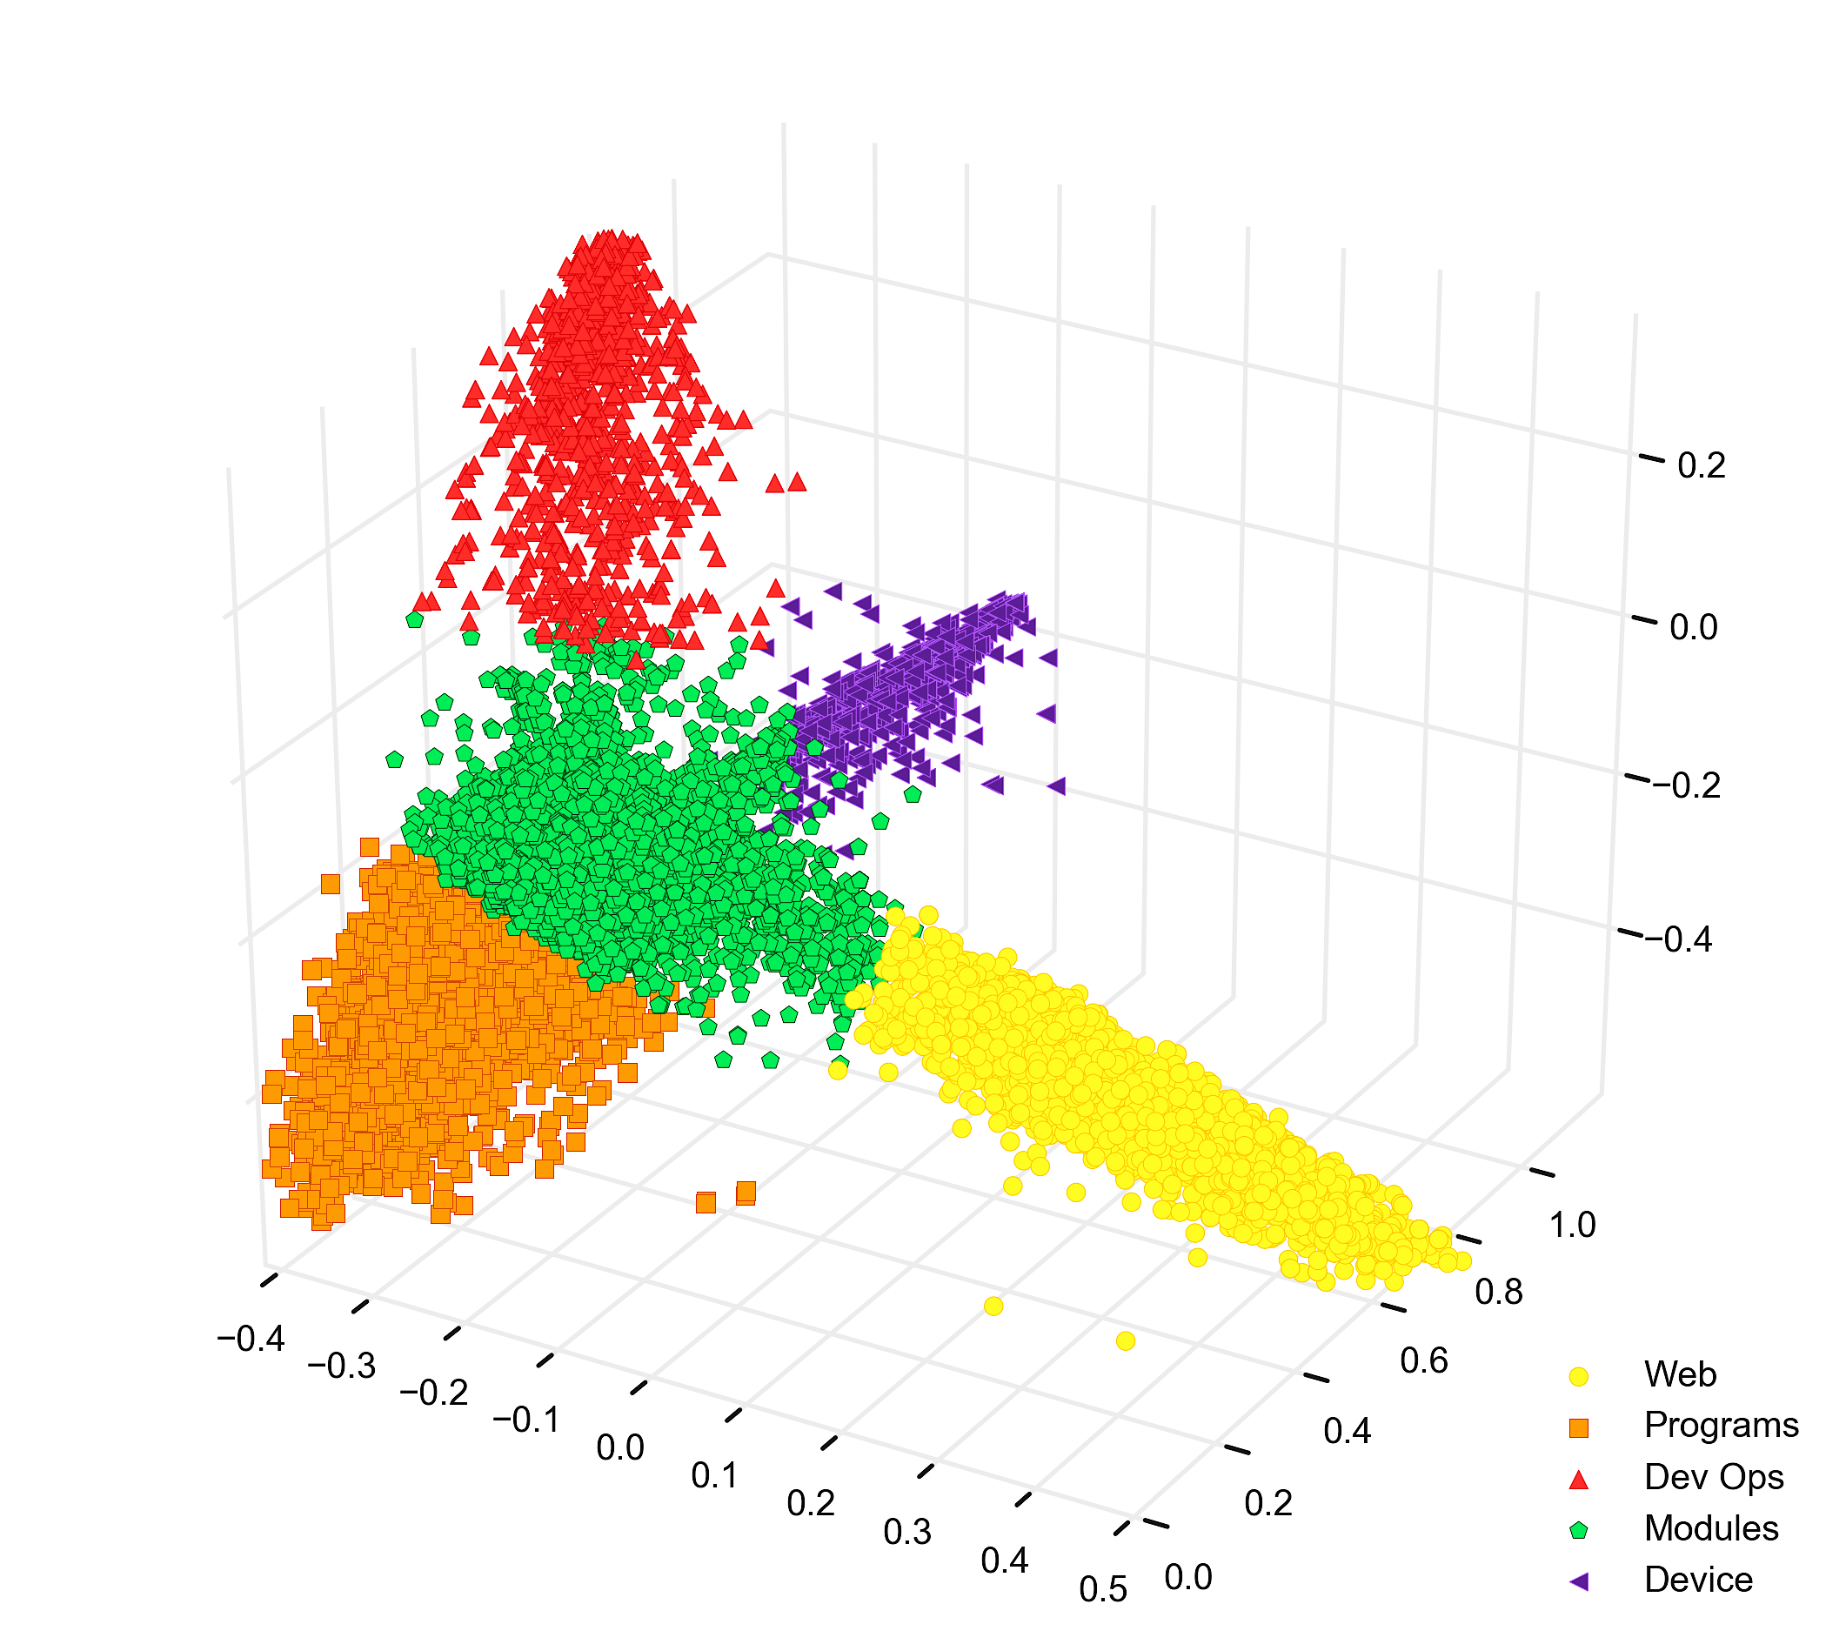

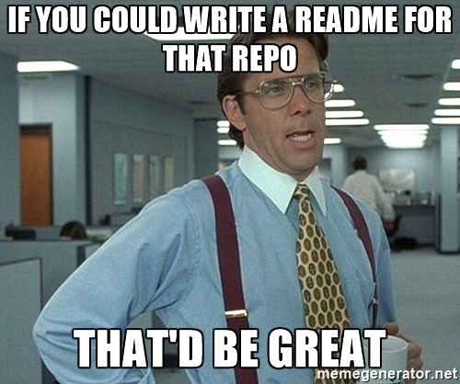
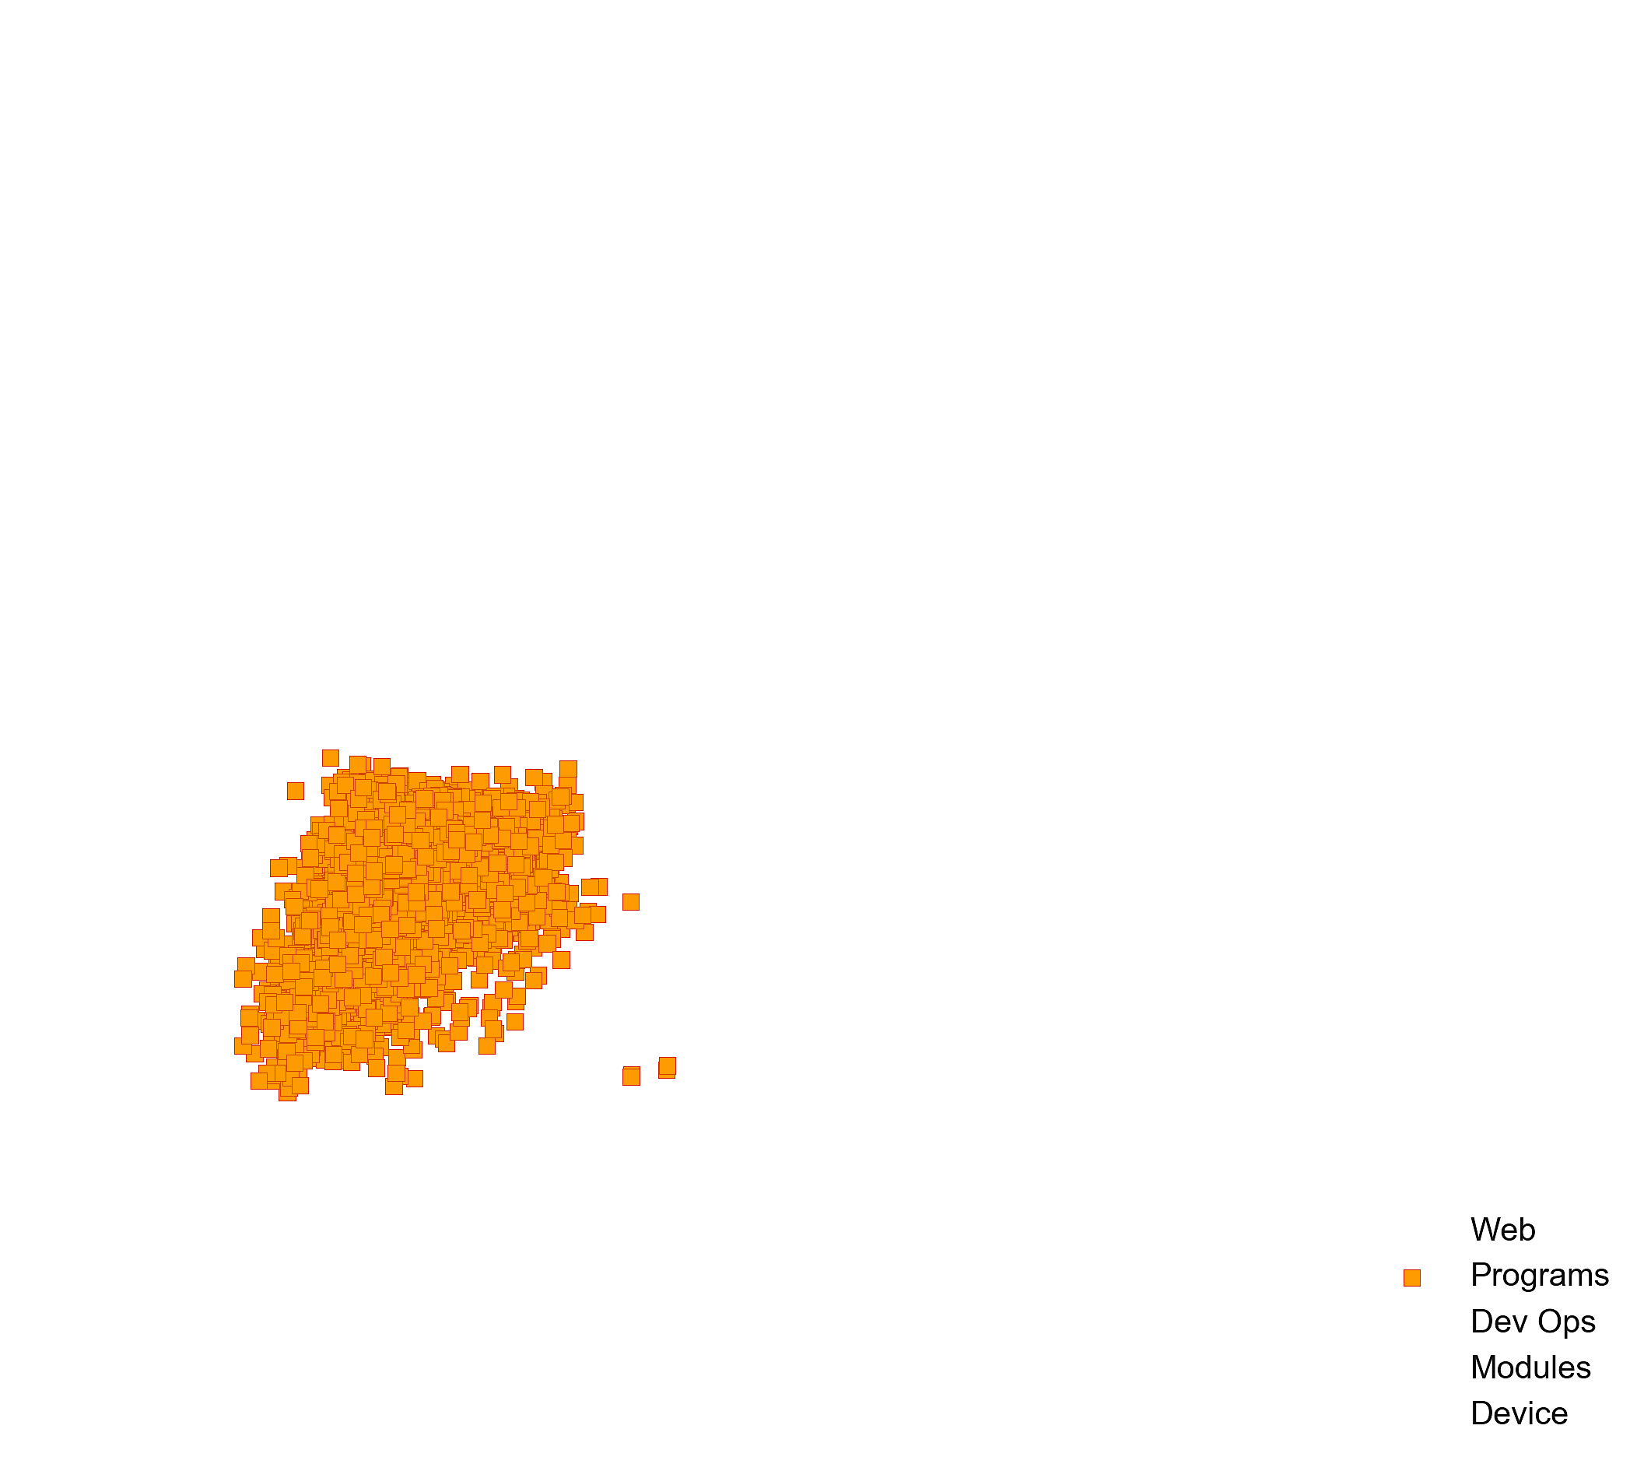
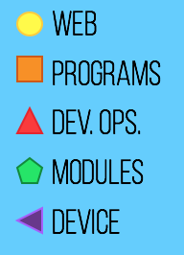
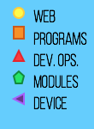
sklearn
numpy
pandas
matplotlib
nltk
...

Slide 6

>>> import smartImport as si
>>> si.get_library()
[‘sklearn’, ‘numpy’, ‘pandas’, ‘matplotlib’, ‘nltk’]
>>> import nltk
>>> si.get_coalesce()
[‘re’, ‘string’, ‘textblob’, ‘matplotlib’]

Slide 7

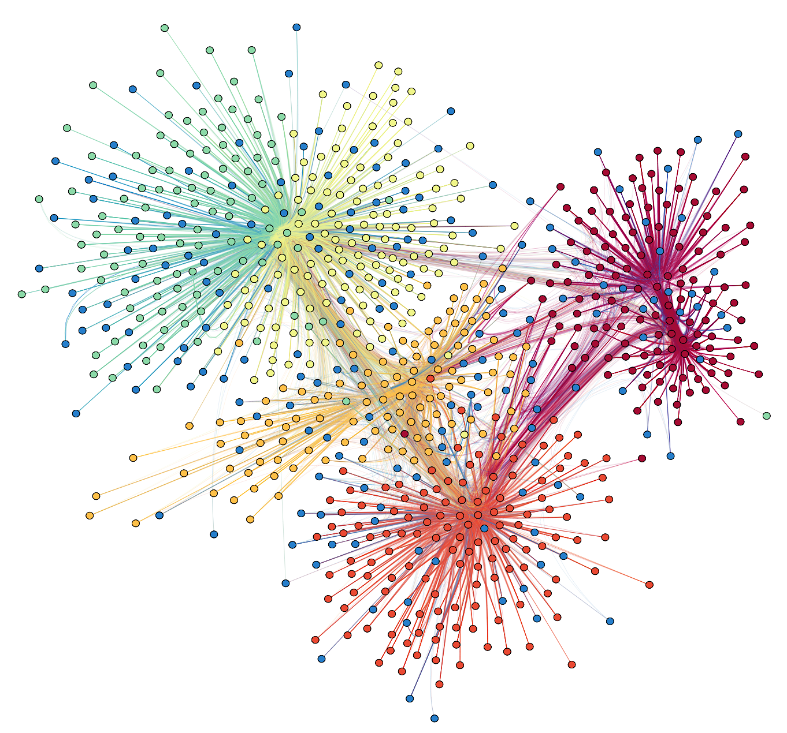
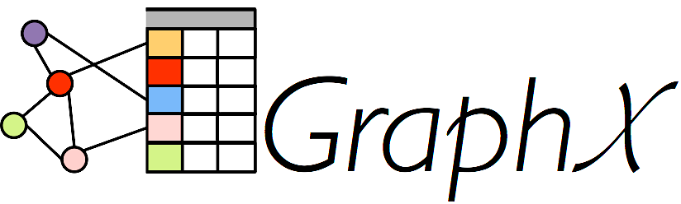

Slide 8




Bryant Biggs
www.linkedin.com/in/bryantbiggs
github.com/bryantbiggs
medium.com/big-data-engineering

